Slide 1

1-Dimensional
2-Dimensional
n-Dimensional
Feature 1
Feature 2
Feature 3
Feature 4
Feature 5
IDs
Feature 1
Feature 2
Feature 3
Feature 4
Feature 5
n-Dimensional
PC2
PC1
PC1
PC2
PC3
Feature 1
Feature 2
Feature 3
Feature 4
Feature 5

Slide 2
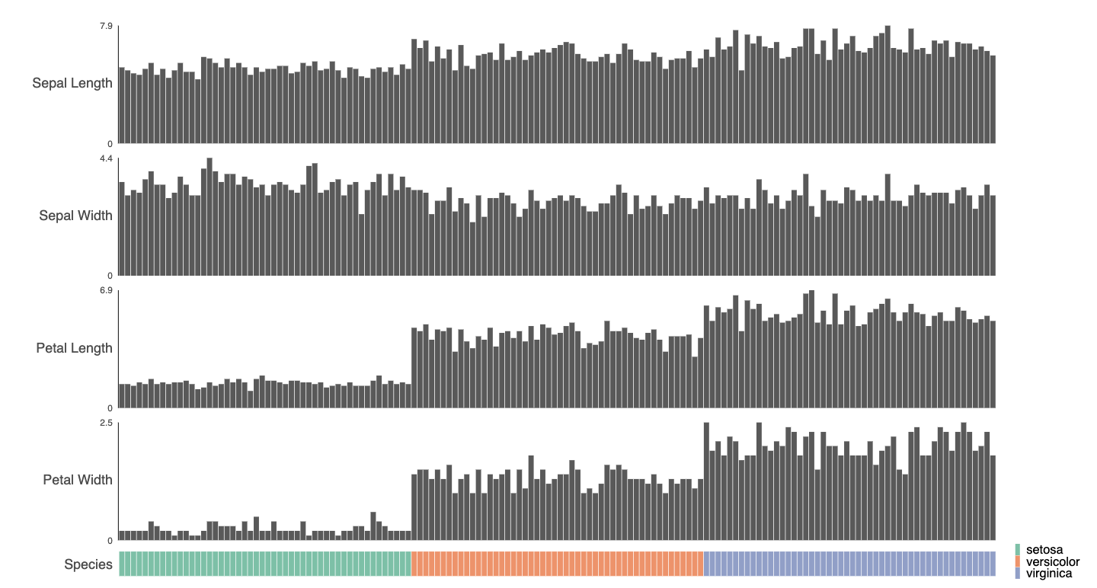
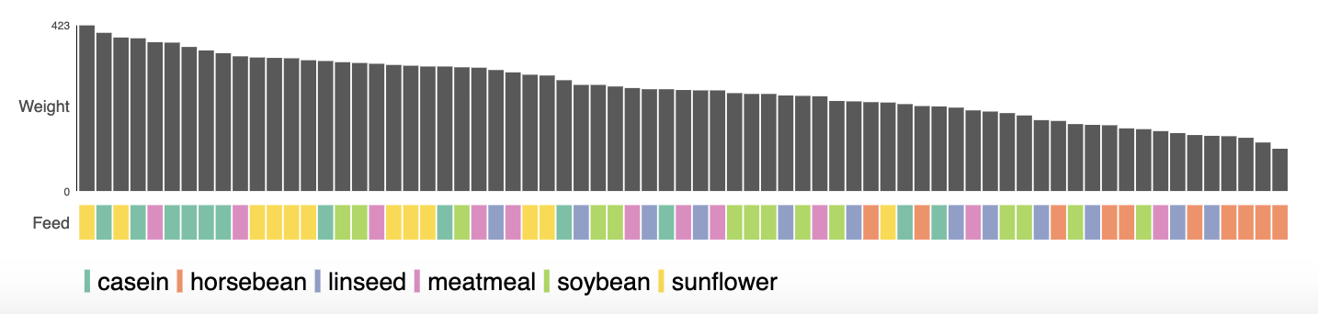
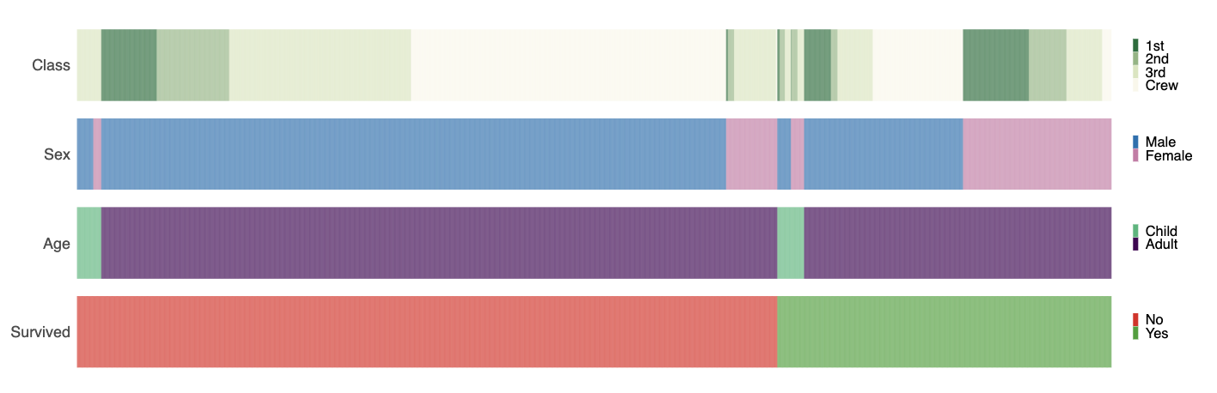
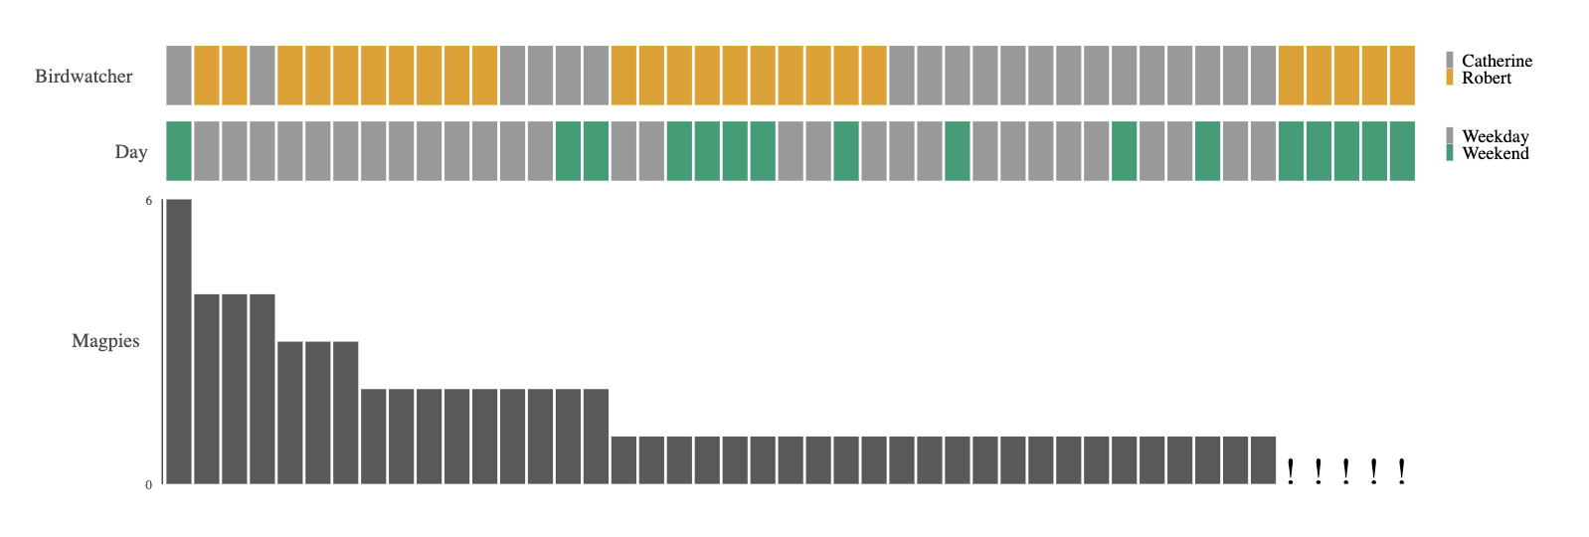
IRIS
Chicken Weights by Feed
Titanic
Lazy Birdwatcher

Slide 3
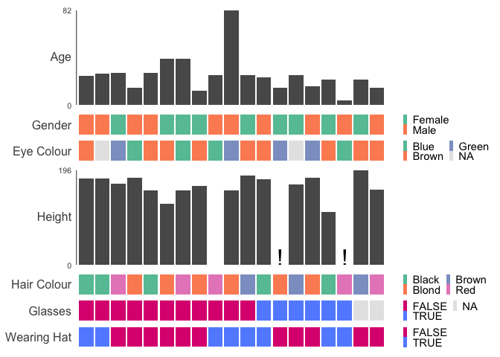
Figure 1
A
B

Slide 4
A
Iris
Titanic
B
C
Palmer Penguins

Slide 5
A
Iris
B
Titanic
C
Palmer Penguins

Slide 6
A
Iris
B
Titanic
C
Palmer Penguins

Slide 7
A
Iris
B
Titanic
C
Palmer Penguins

Slide 8
Feature | gg1d | Complex Heatmap | Data Explorer | skimr | GGally | ggpcp
Automatic Plot Generation | ✔️ | ❌ | ✔️ | ✔️ | ✔️ | ❌
Automatic plot selection by variable type | ✔️ | ❌ | ✔️ | ❌ | ✔️ | ❌
Interactive Visualisations | ✔️ | ❌ | ❌ | ❌ | ❌ | ❌
Supports cross-linking with other datasets | ✔️ | ❌ | ❌ | ❌ | ❌ | ❌
Composable with Patchwork | ✔️ | ✔️ | ❌ | ❌ | ✔️ | ✔️
Supports parallel coordinate plots | ✔️ | ❌ | ❌ | ❌ | ✔️ | ✔️
Describes features contribution to total variance (PCA) | ❌ | ❌ | ✔️ | ❌ | ❌ | ❌
Generates Publication Quality Figures | ✔️ | ✔️ | ❌ | ❌ | ✔️ | ✔️
Graphical User Interface is available | ✔️ | ✔️ | ❌ | ❌ | ❌ | ❌
Reveals missingness dependent on multiple features | ✔️ | ❌ | ❌ | ❌ | ❌ | ❌

Slide 9
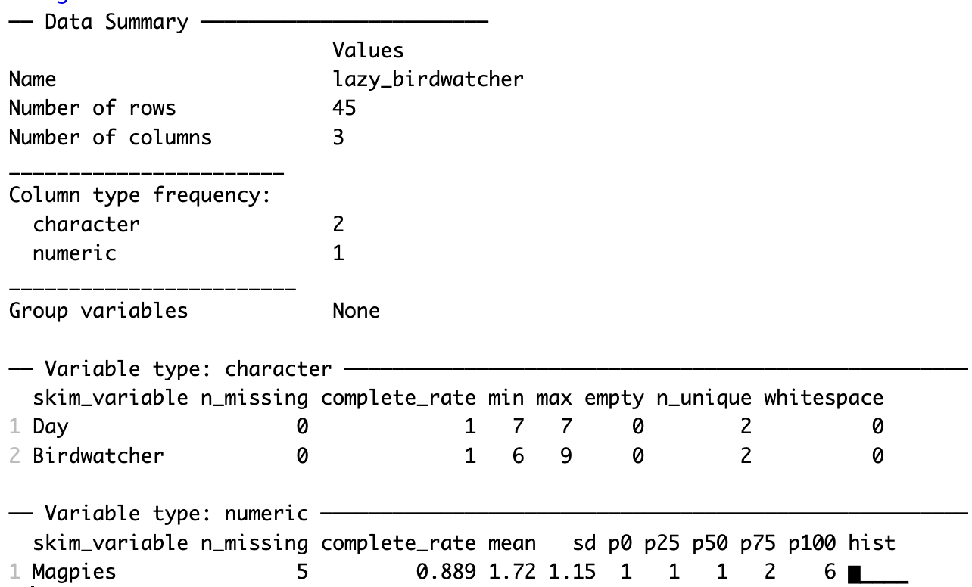
A
gg1d
Reveals drivers of missingness
B
skimr
C
GGally
Only reveals that missing values are present
Missing Data Ignored

Slide 10
A
B

Slide 11
A
B

Slide 12
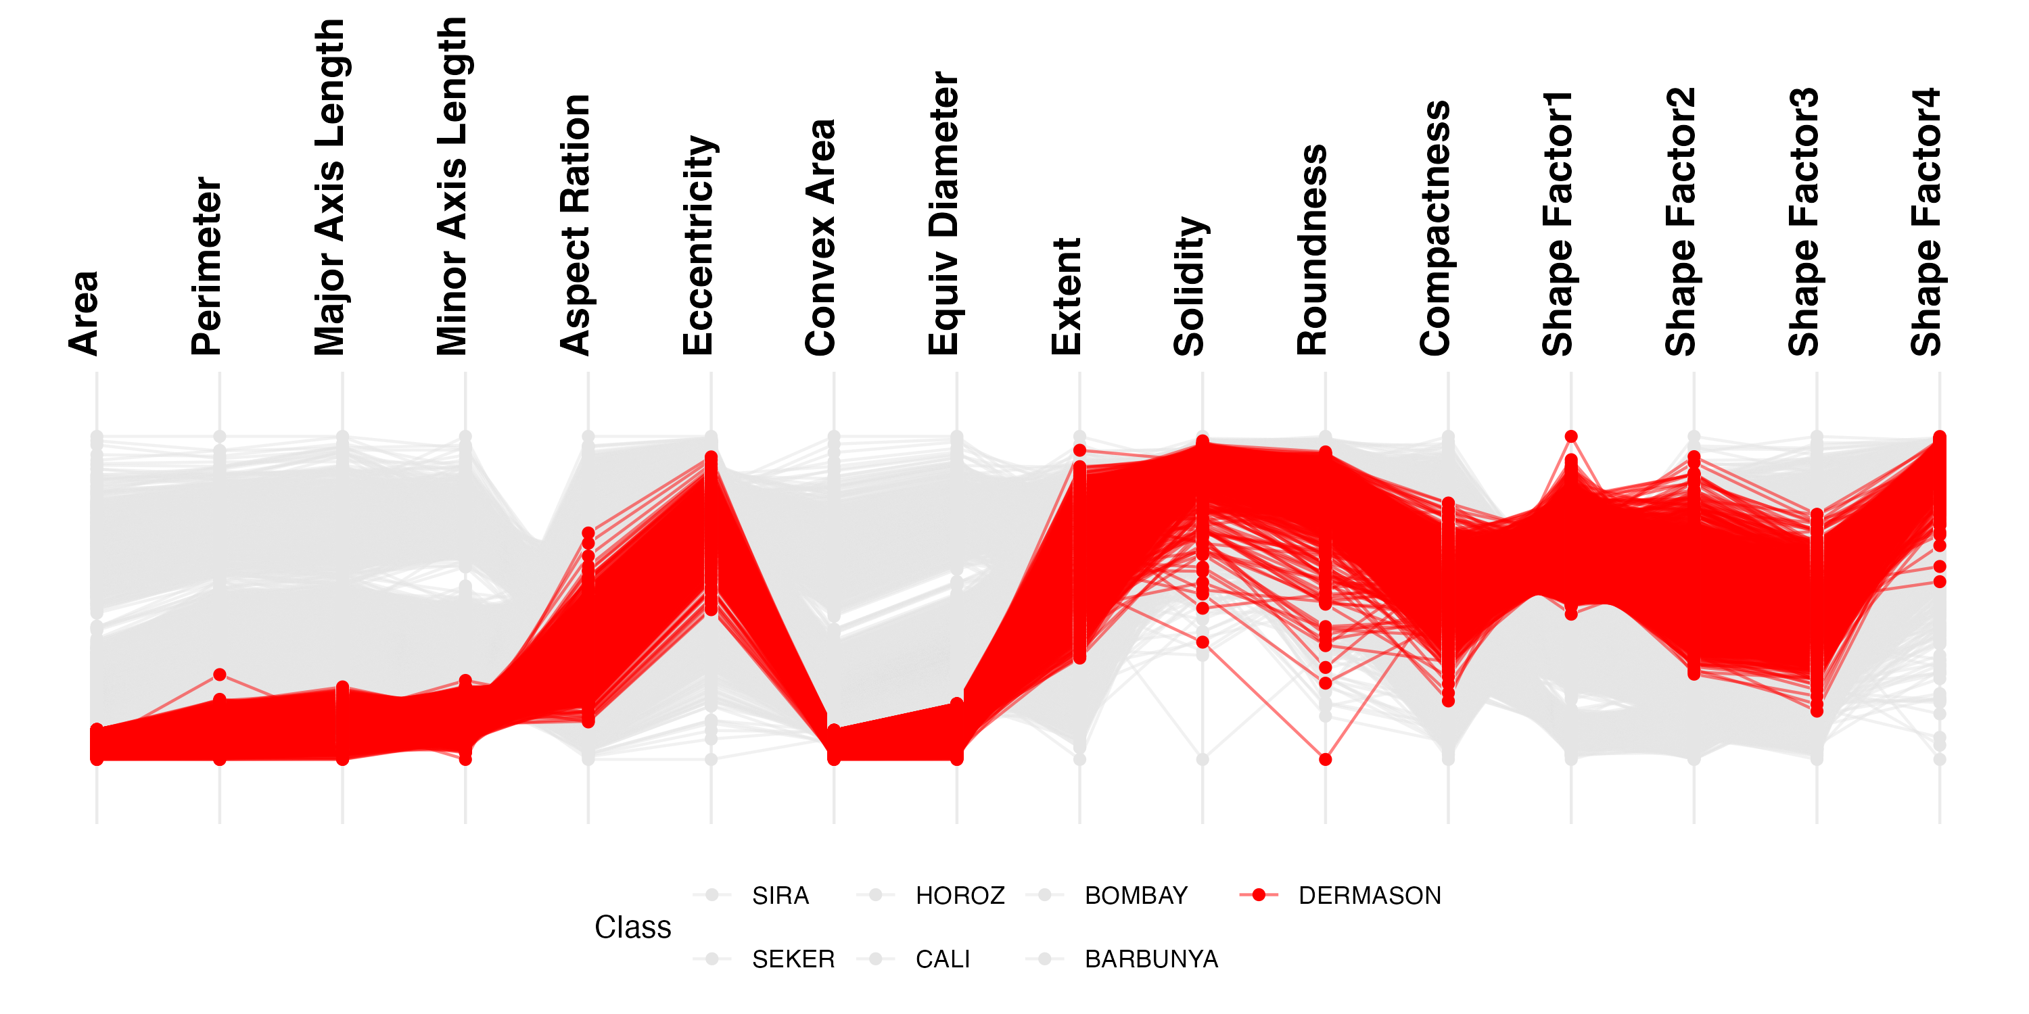
A
B

Slide 13
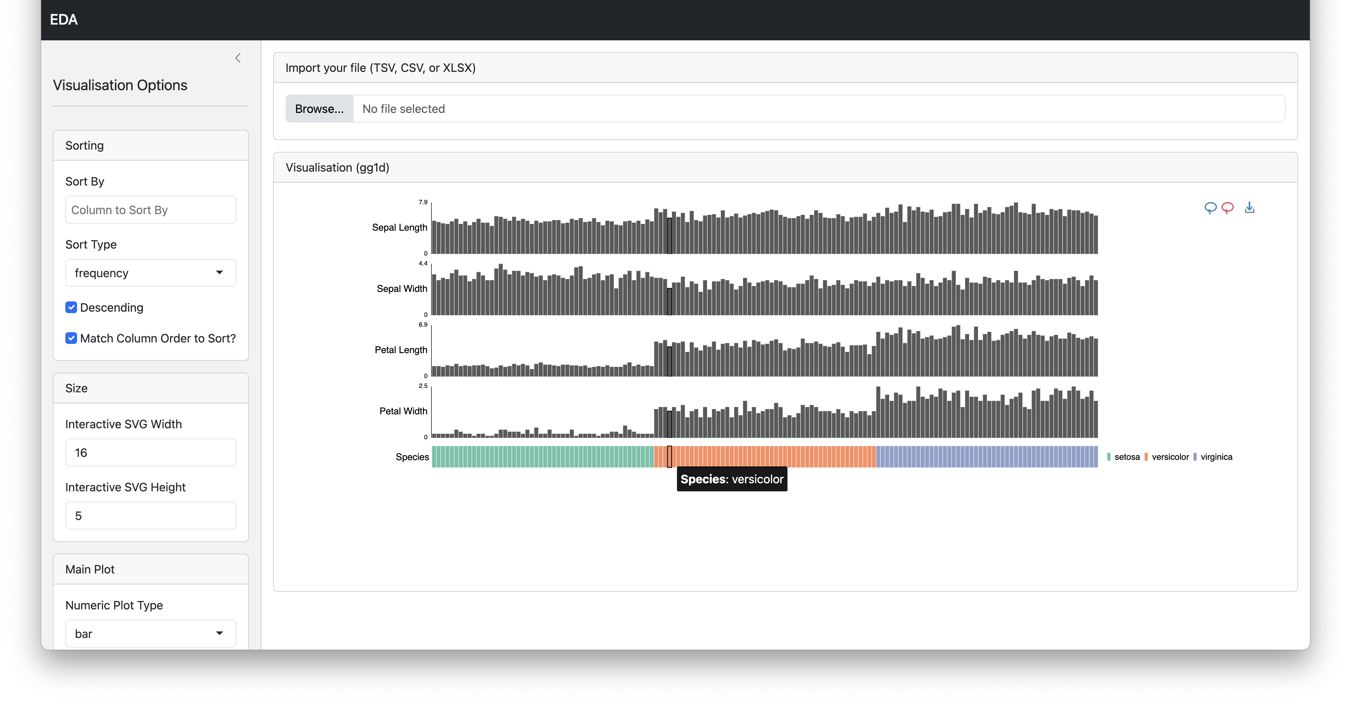

Slide 14
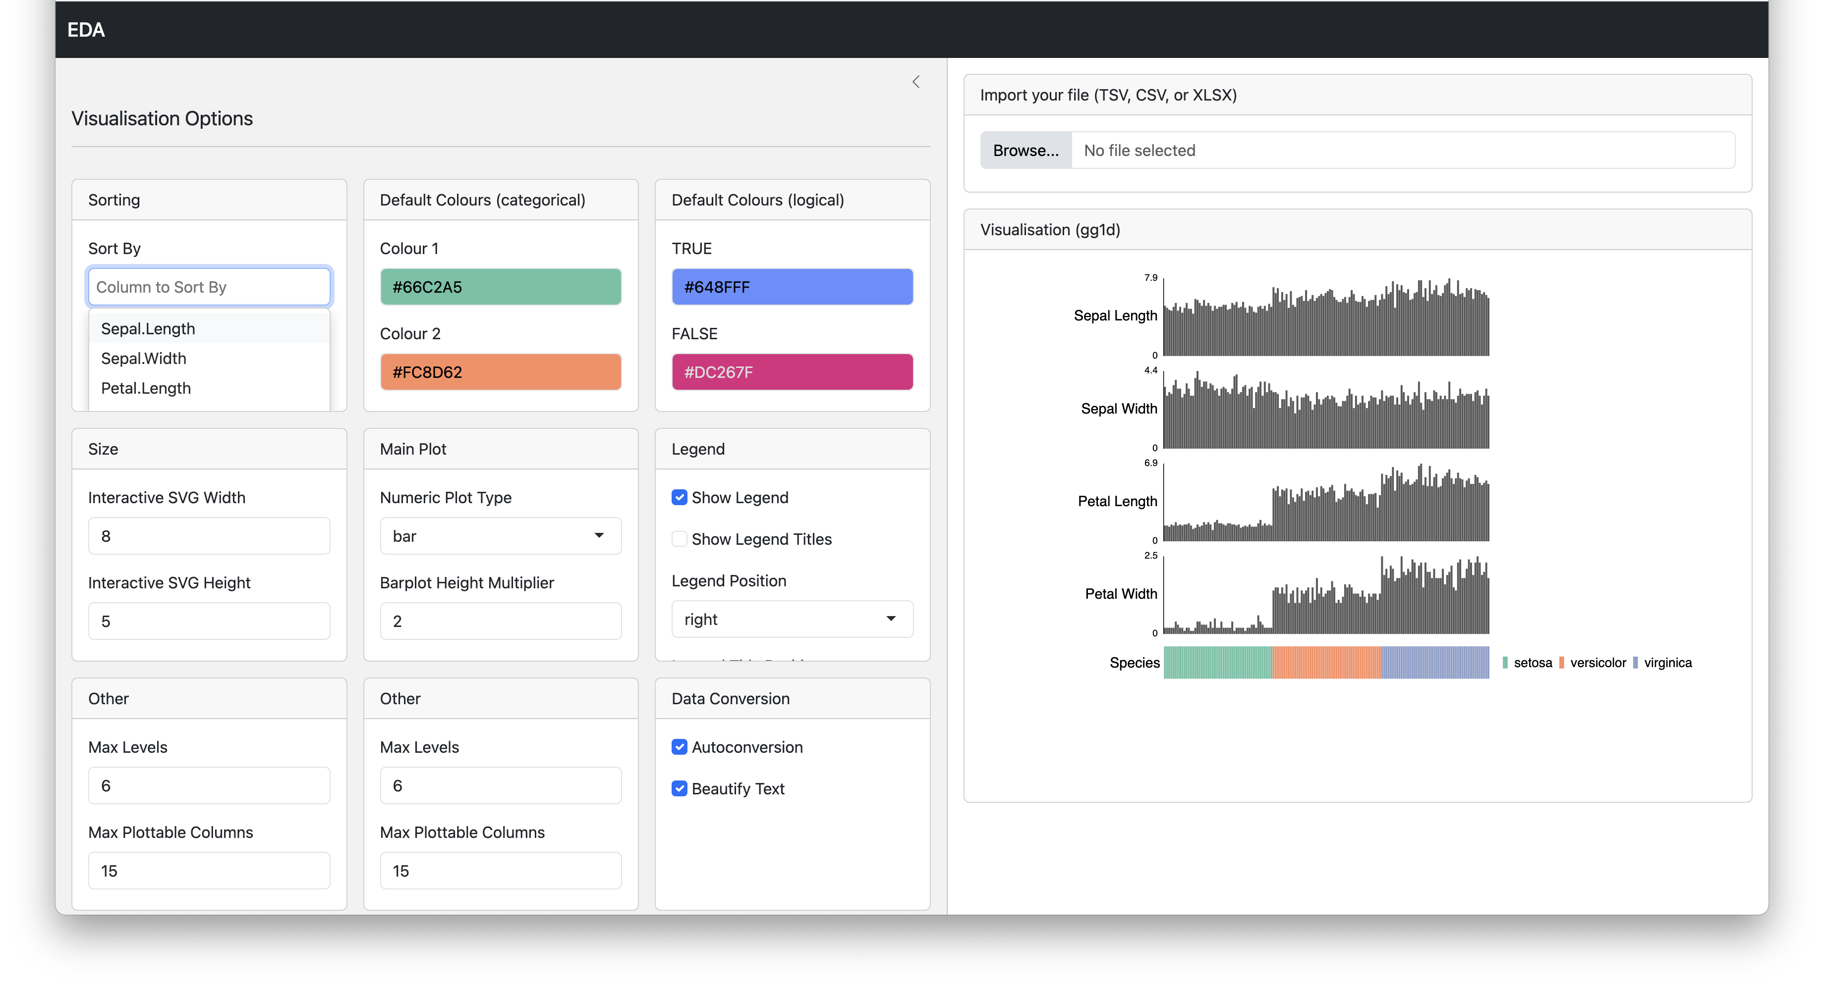

Slide 15
Features
Automatic plot type selection based on relationships.
Single Function
Interactive

